Slide 1
Digital Devices Final Project: Multiple Traffic light Controller with Emergency Light.
Mykel Edwards

Slide 2
Introduction
Building the small-scale traffic signal by blueprint and programming the traffic signal and controller with emergency signal.
Added more lights during course of this project as well as motion detector that activates with vehicle approaching.
Inventory and Cataloguing of parts to start project

Slide 3
Project Preparation

Slide 4
Inventory (Picture)
ESP 32 Board
Colored LEDs: Red, Yellow, Green, and Blue
220 Ohm Resistors (optional)
Wires
Breadboard(s)
LCD Unit with I2C Adapter
Active Buzzer
Mini Router
Push Button(s)
PIR Motion Sensor

Slide 5
ESP32 (Picture)
Microcontroller mounted and powered ON
Write your name on a piece of paper and place it next to your circuit , then take a picture of your project.

Slide 6
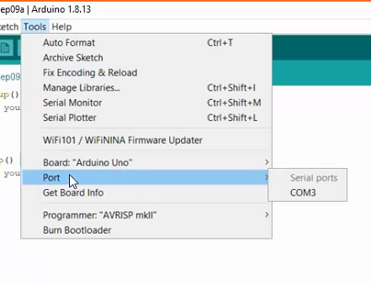
Installation of Arduino IDE
Screenshot of Arduino IDE with Port selected from Tools menu.
Example

Slide 7
ESP32 WiFi Scan
Screenshot of Serial Monitor in Arduino IDE showing the available networks

Slide 8
Creating the Traffic Controller

Slide 9
Picture of circuit with working LEDs
ESP 32 Board
Colored LEDs: Red, Yellow and Green
220 Ohm Resistors (optional)
Wires
Breadboard

Slide 10
Screenshot of code in Arduino IDE
Screenshot of code in Arduino IDE showing your name in the comment

Slide 11
Creating Multiple Traffic Lights

Slide 12
Picture of circuit with working LEDs
ESP 32 Board
Colored LEDs: Red, Yellow and Green (two sets)
220 Ohm Resistors (optional)
Wires
Breadboard

Slide 13
Screenshot of code in Arduino IDE
Screenshot of code in Arduino IDE showing your name in the comment

Slide 14
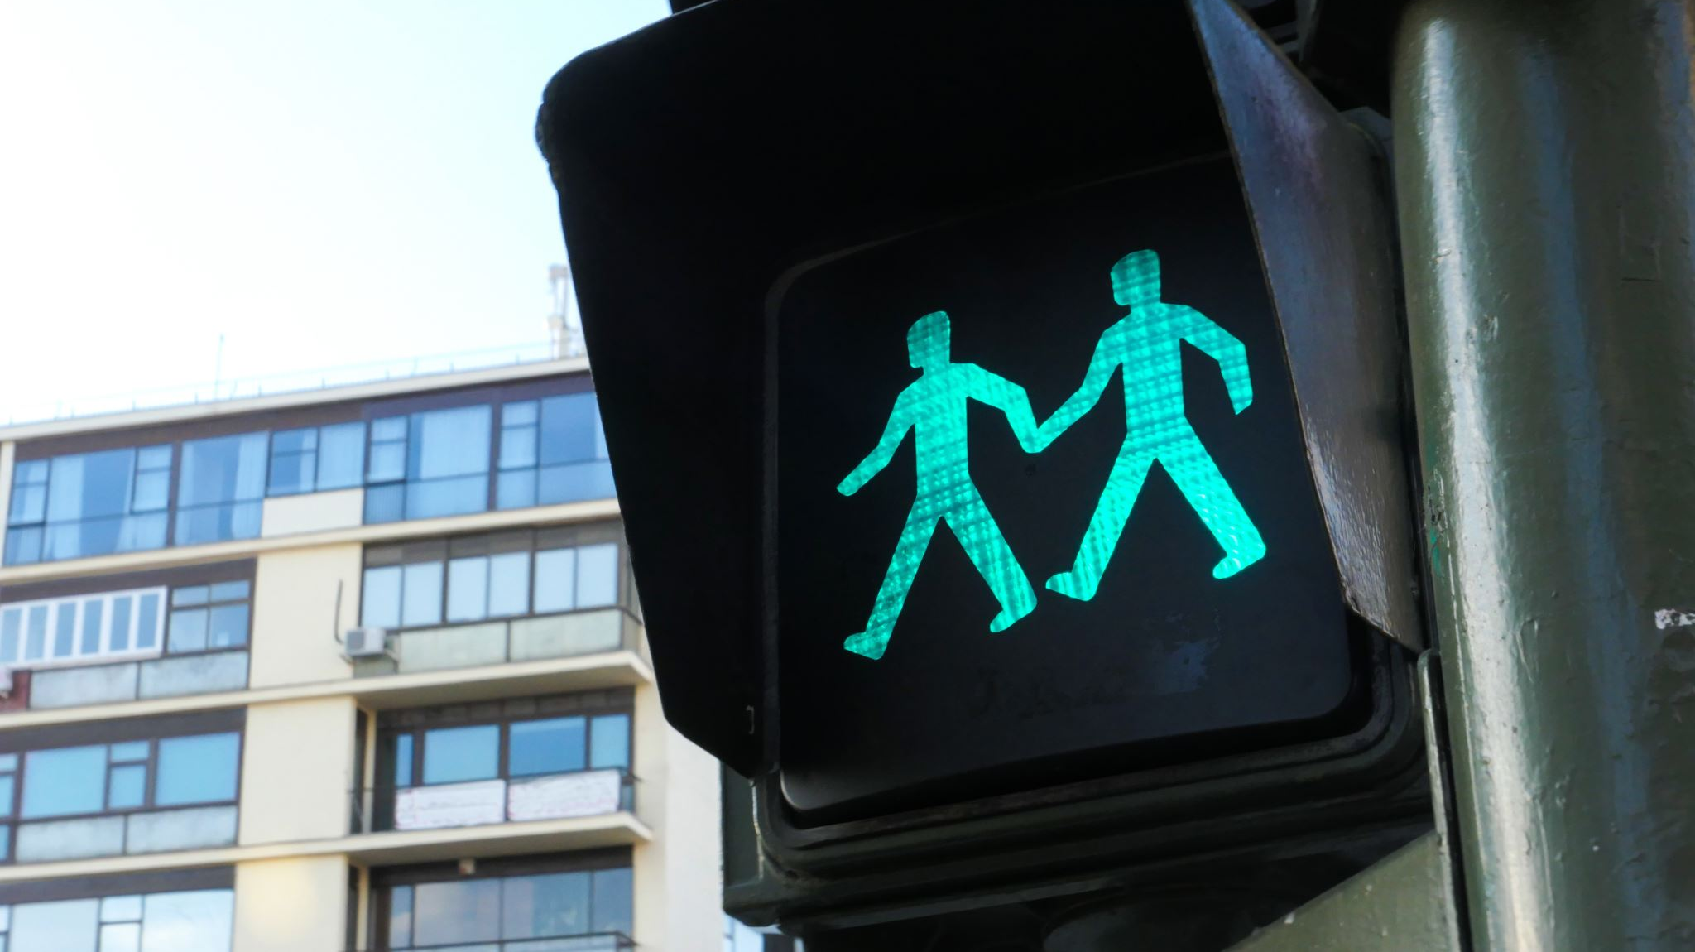
Creating a Multiple Traffic Light Controller While Integrating a Crosswalk Button

Slide 15
Picture of circuit with working LEDs
ESP 32 Board
Colored LEDs: Red, Yellow and Green (two sets)
220 Ohm Resistors (optional)
Push Button
Wires
Breadboard

Slide 16
Screenshot of code in Arduino IDE
Screenshot of code in Arduino IDE showing your name in the comment

Slide 17
Screenshot of Serial Monitor in Arduino IDE
Screenshot of output in Serial Monitor

Slide 18
Creating a Multiple Traffic Light Controller With A Cross Walk and Emergency Buzzer

Slide 19
Picture of circuit with working LEDs and LCD display
ESP 32 Board
Colored LEDs: Red, Yellow and Green (two sets)
220 Ohm Resistors (optional)
Push Button
LCD Unit with Message Display
Wires
Breadboard

Slide 20
Screenshot of code in Arduino IDE
Screenshot of code in Arduino IDE showing your name in the comment

Slide 21
Screenshot of Serial Monitor in Arduino IDE
Screenshot of output in Serial Monitor

Slide 22
Creating A Multiple Traffic Light Controller with Emergency Light

Slide 23
Screenshot of circuit with working LEDs and LCD display (Building/Operation)
ESP 32 Board
Colored LEDs: Red, Yellow and Green (two sets)
One Blue LED – Emergency Light
220 Ohm Resistors (optional)
Push Button
LCD Unit
Buzzer
Wires
Breadboard

Slide 24
Screenshot of code in Arduino IDE (Testing)
Screenshot of code in Arduino IDE showing your name in the comment

Slide 25
Screenshot of Serial Monitor in Arduino IDE (Testing)
Screenshot of output in Serial Monitor

Slide 26
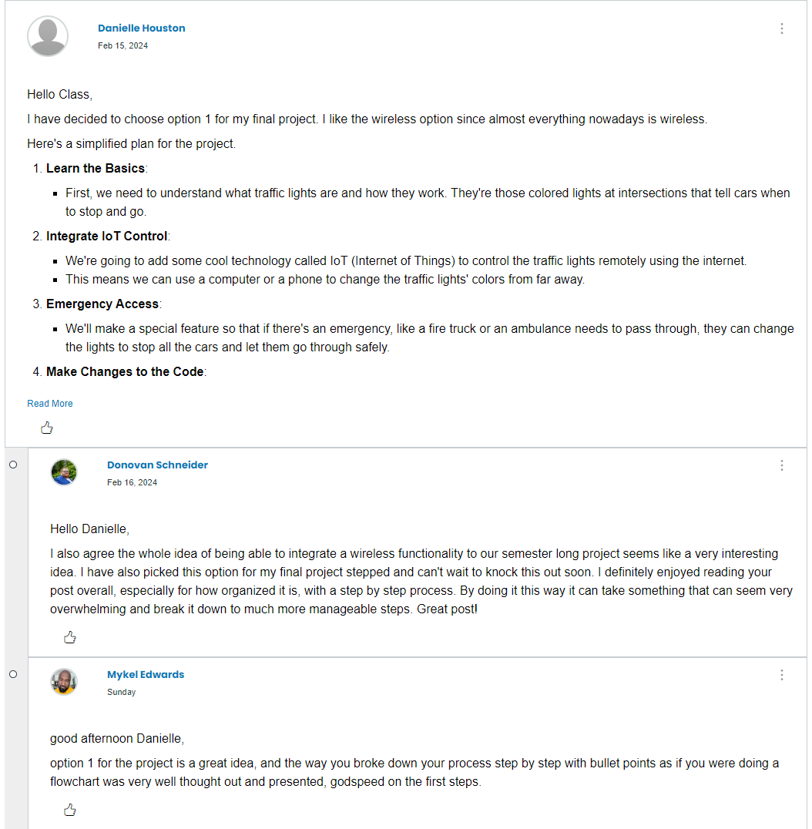
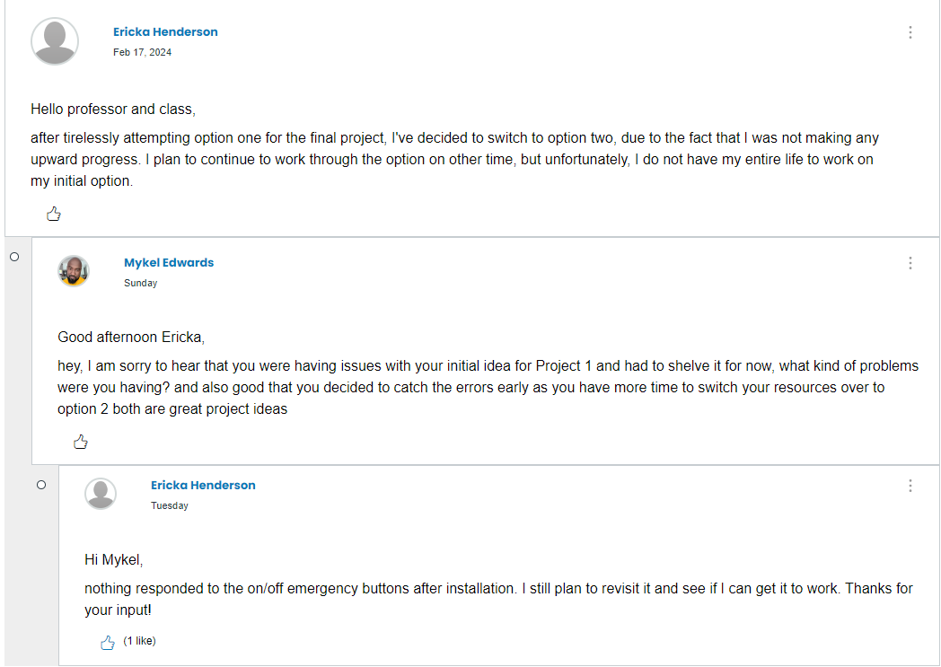
Peer Review

Slide 27
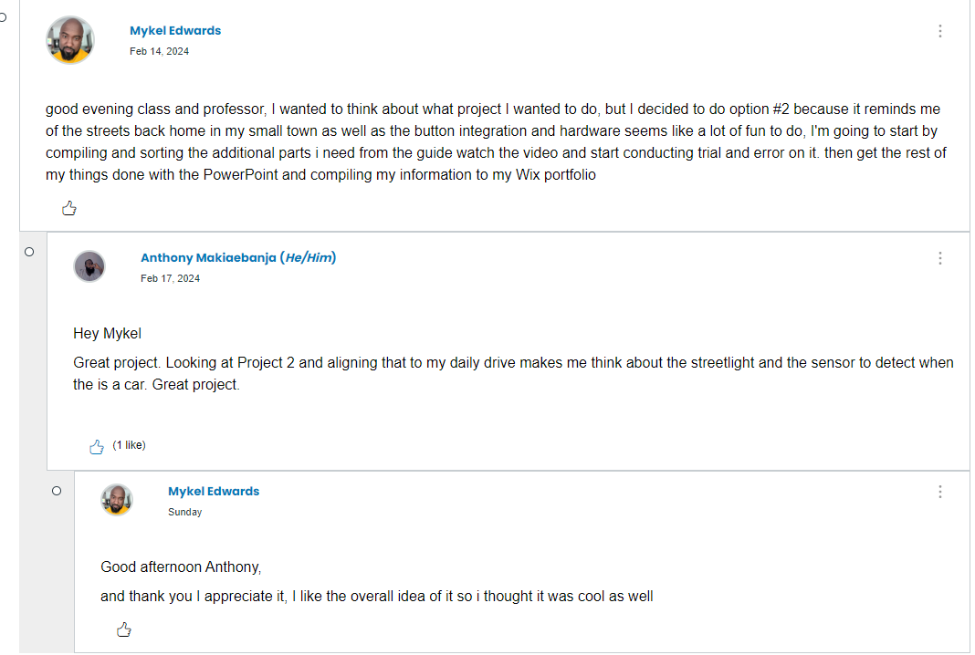
Reflection

Slide 28
Challenges
During the course of the project and class a few challenges arose
I had Arduino issues earlier on trying to connect with my ESP32 Board, so my program wasn’t running
Then I had issues with my ESP32 board not responding to the code, so I had no life when I plugged into my computer
And my contrast was too high on my LCD during initial install so I thought I had a faulty LCD had to troubleshoot

Slide 29
Career Skills
More In depth hardware knowledge
Networking and connectivity ability
Programming/ Coding
Operating System Fundamentals
Automation
Security Awareness
Understanding of IoT

Slide 30
References
Project Strategy Guides
Class Modules
Live Class/Review
DeVry Library

Slide 31
Conclusion
The Internet of Things (IoT) is growing exponentially. New technologies and applications are being developed on a regular basis and this creates an abundance of new job opportunities each with its requisite skill sets. It is important to stay current with the skills required for this evolving job market and to take advantage of the many available learning opportunities currently available
The individual projects throughout the course help us deal with different challenges with data, like monitoring, managing and keeping secure large quantities of data.

