Slide 1
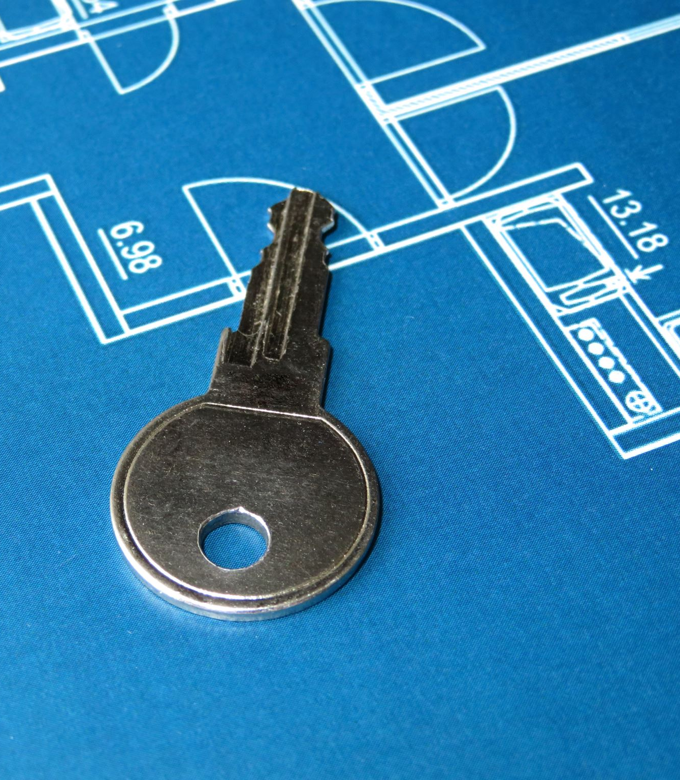
CEIS101 COURSE PROJECT SMART HOME AUTOMATION AND SECURITY SYSTEM
CEIS101 Final Course Project
November 2023
Mykel Edwards
Prof. Dr. Rajin KoonjBearry

Slide 2
Table of Contents
Introduction
Module 2
Circuit Simulation in Tinkercad
Module 3
Inventory of parts, Circuit Building, and Displaying Messages
Module 4
Adding Door Sensor to Smart Home System
Module 5
Adding Distance Sensor to Smart Home System and Conducting Data Analysis
Module 6
Adding Automated Light to Smart Home System
Ending Slides
Challenges
Conclusions
References

Slide 3
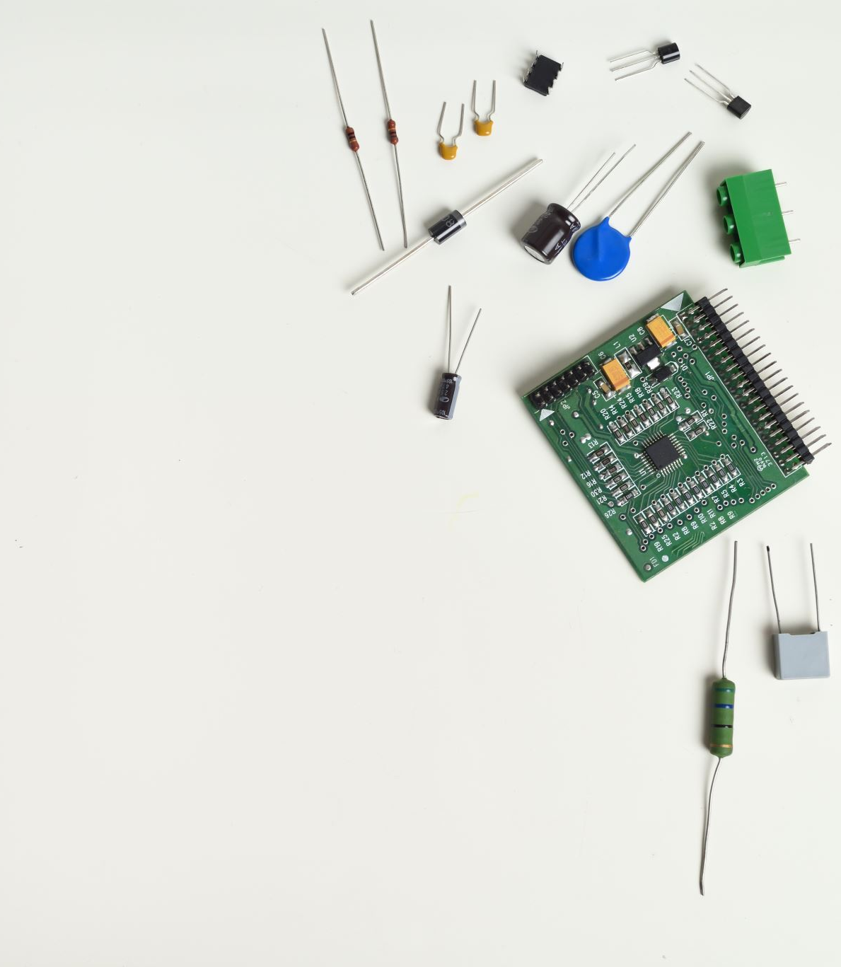
Introduction
The Internet of Things (IoT) is growing exponentially. New technologies and applications are being developed on a regular basis and this creates an abundance of new job opportunities each with its requisite skill sets. It is important to stay current with the skills required for this evolving job market and to take advantage of the many available learning opportunities currently available. This course project covers the fundamental concept of the IoT by integrating hardware, software, and networks into a whole system. The project is divided into six parts where each part builds upon the previous resulting in an IoT device that will simulate a home automation and security system. The design and development process of this project truly encompasses various aspects of the IoT and will prepare you for your future career in technology. Scenario In this project, I developed a smart home automation and security system.
by designing the prototype in Tinkercad
building the hardware with the components from the IoT Tech Core Kit
and programming within Arduino IDE.
The smart home system will encompass various devices to monitor the condition of the home. This includes a door sensor to check whether to door is open or closed, a distance sensor to monitor for a possible home intruder, and automated lights that turn on when it is dark.

Slide 4
Circuit screenshot

Slide 5
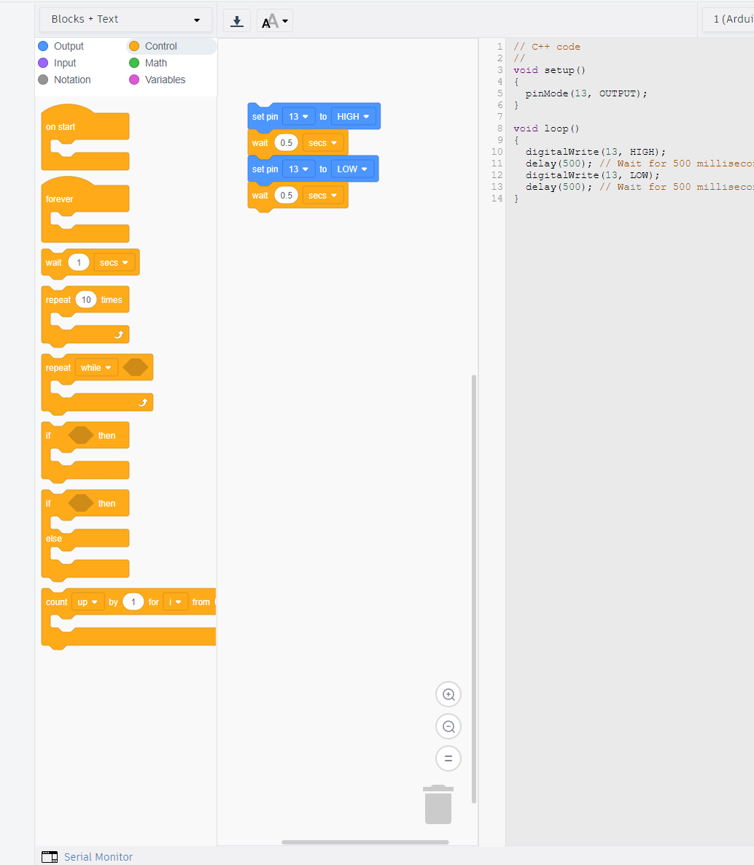
Code (screenshot)

Slide 6
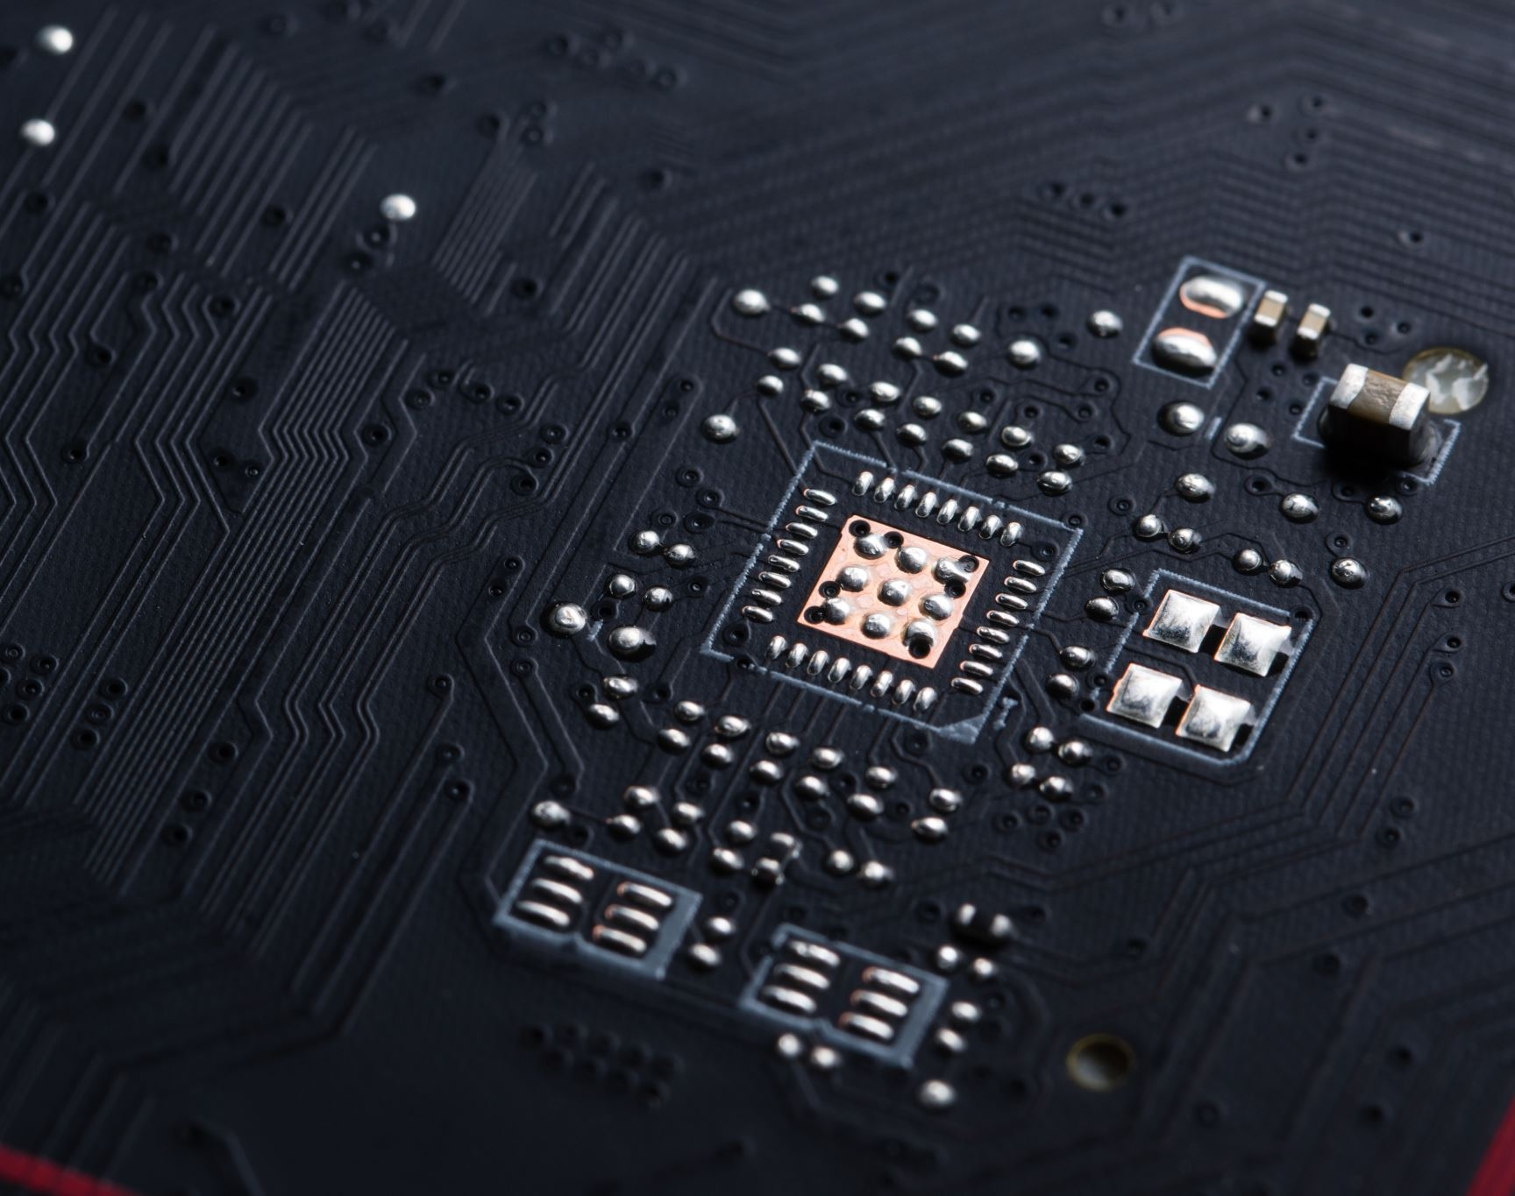
Inventory of Parts, Circuit Building, and Displaying Messages

Slide 7
Inventory of IoT Kit (picture)
UCTRONICS Kit
ESP32 (2)
LCD Modules (2)
Breadboards (3)
Mini Router
Patch Cable
Digital Multi Meter
USB to Micro USB (2)

Slide 8
Organization of Project Components (picture)
Arduino Mega 2560
Breadboard
Resistor 10kΩ
LEDs
Ultrasonic Sensor
Active Buzzer
Photoresistor
Wires
USB Type B cable

Slide 9
Circuit with red LED on (picture)

Slide 10
Serial Monitor (screenshot)

Slide 11
Adding Door Sensor to Smart Home System

Slide 12
Circuit of door closed with Green LED ON (picture)

Slide 13
Circuit of door open with Green LED OFF (picture)

Slide 14
Arduino Code (screenshot)

Slide 15
Serial Monitor (screenshot)

Slide 16
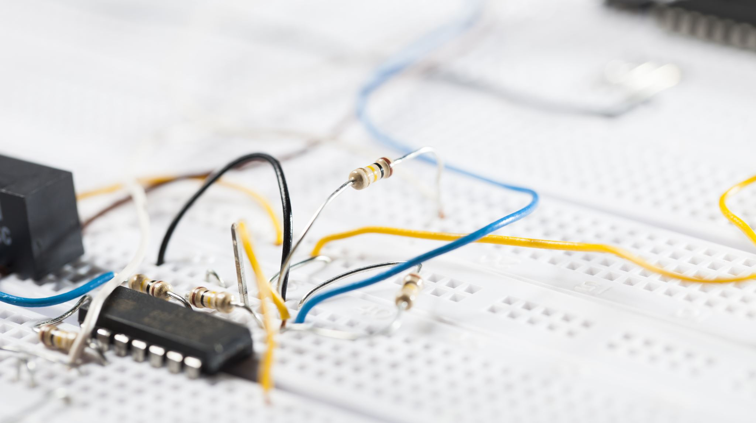
Adding Distance Sensor to Smart Home System and Conducting Data Analysis

Slide 17
Circuit with green LED on (picture)

Slide 18
Circuit with yellow LED on (picture)

Slide 19
Circuit with red LED on (picture)

Slide 20
Arduino Code (screenshot)

Slide 21
Plot of data (graph from Excel)

Slide 22
Adding Automated Light to Smart Home System

Slide 23
Circuit with automated LED off (picture)

Slide 24
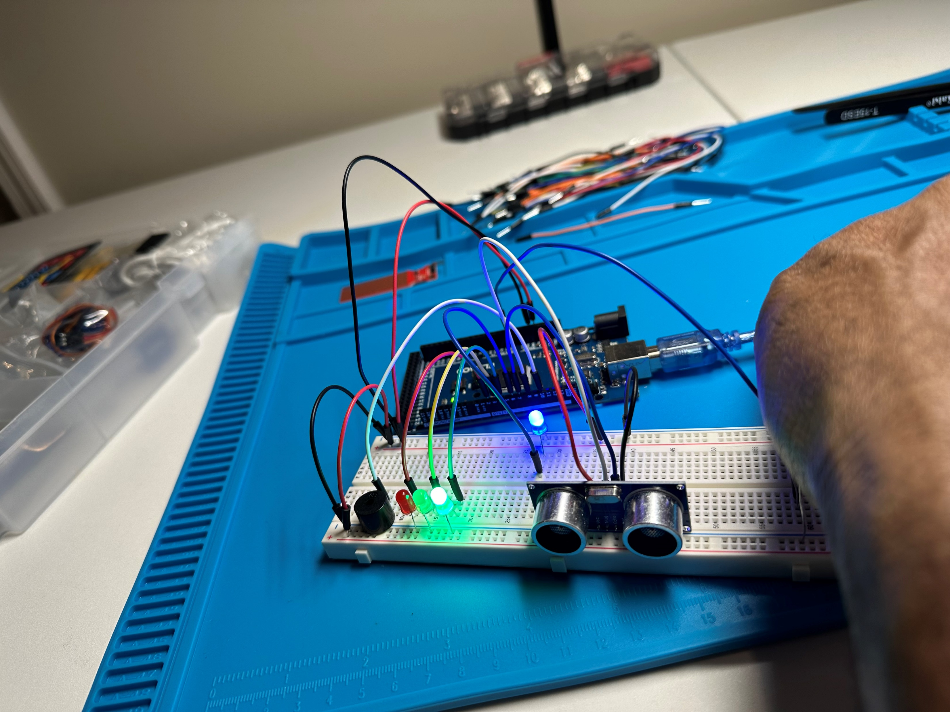
Circuit with automated LED on (picture)

Slide 25
Arduino Code (screenshot)

Slide 26
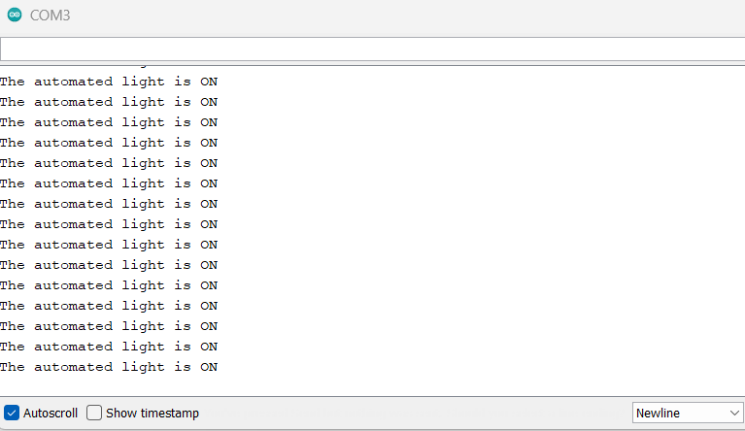
Serial Monitor (screenshot)

Slide 27
Challenges/Lessons Learned
Some of the challenges that came up were:
There was a few instances while I was trying to get the code to translate over into Arduino it wouldn’t take and I was getting a read error. And incorrect compiling format, also an issue when I was trying to transpose from the serial monitor to excel to plot my data.
I had to slow down and take a step back before I got frustrated because I had run the code instance a few times, I realized that my code was incomplete after back tracking, also with the excel issue, I troubleshooted with some of my classmates in a group and we went to an earlier version of the application which allowed us to pop out the monitor and adequately copy the code and transfer to excel to plot data.
I learned from those challenges to slow down and that it’s always another way sometimes just have to change your angle.

Slide 28
Career Skills
Hardware/device knowledge
Networking/connectivity ability
Coding/programming
Operating System fundamentals
Basic business intelligence and data analytic knowledge
Automation
Minimum security awareness

Slide 29
Conclusion
To Paraphrase my professor a little bit this project was a lovely intro into the world of IoT!
After doing this project and engaging in discussions I had the opportunity to really find out how bit and rapidly expanding the industry of IoT is becoming.
It was an exhilarating experience using a new interface like Tinkercad as well as Arudino to be able to code and create computer language on the software side, and then the many steps it takes to translate that to the hardware
So learning the differences between of how to use the breadboard and wire it up the circuits with the LEDs and so forth
The experience has just taken me one step closer to my enriching career path ahead.

Slide 30
References
DeVry Module Learning
Live Playback Lessons from Professor
Project Videos

