Slide 1
Wired,Optical &
Wireless Communications
Final Project
By: Mykel Edwards
Professor: Daniel Dronsick

Slide 2
Introduction
This class was an introduction into modulation mechanisms, encoding schemes, characteristics of wireline and wireless transmission media that make digital transmission possible. The implementation and analysis of simulations involve baseband signals, AM/FM signals, Pulse Code Modulation (PCM), line codes, antenna gain, free space path loss, and fading channels. This experience will enable the integration of IoT technologies and prepare myself and classmates for our future careers in Information Technology.

Slide 3
Table of contents
Baseband Signals & AM/FM Signals
Pulse Code Modulation & Line Codes
Cables and Structured Cabling
Antenna Gain & Free Space Path Loss
Bit Error Rat of Fading Channels

Slide 4
Baseband Signals and AM/FM Signals

Slide 5
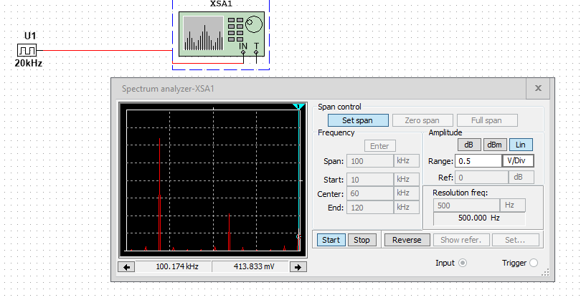
Baseband Signals
The screenshot should show the spectrum analyzer displaying the signal’s harmonic spectrum and its panel settings. Record the signal voltage at each of the frequencies in the table.
SCREENSHOT HERE
Harmonic Frequency | Signal (Volts)
20 kHz | 3.13v
40 kHz | 2.03uv
60 kHz | 866.67mv
80 kHz | 2.04uv
100 kHz | 413.604mv

Slide 6
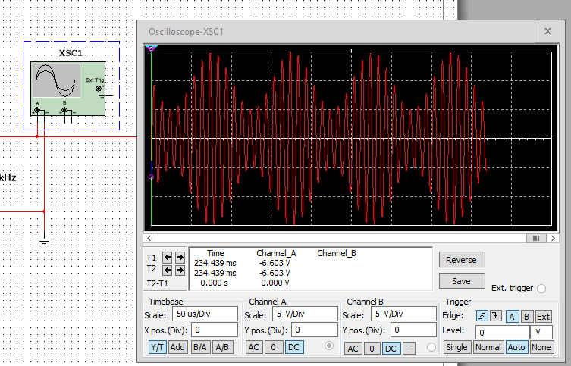
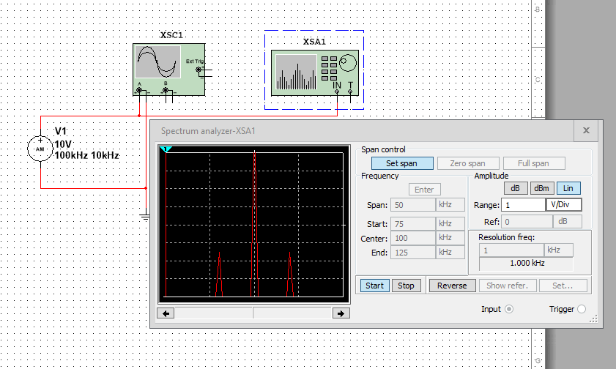
AM Signals
The screenshot of the Oscilloscope should include the signal and the panel settings of the oscilloscope. The screenshot of the Spectrum Analyzer should include the signal and the panel setting of the analyzer.
Spectrum Analyzer screenshot here
Oscilloscope screenshot here
AM Modulation | Frequency (kHz)
Lower side band | 2.289 V
Carrier | 7.921 V
Upper side band | 2.186 V

Slide 7
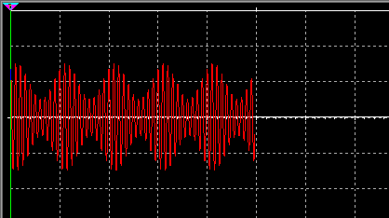
AM Signals Cont.
Develop equations for the carrier and modulating signals and plot the equation for the composite modulated signal V_{AM .}
Plotted diagram screenshot here:
Equations here:
𝑣_{𝐶} = 𝑉p sin(2𝜋𝑓_{𝑐}𝑡 + 𝜃_{𝐶}),
𝑣m = 𝑉m sin(2𝜋𝑓_{𝑖}𝑡 + 𝜃_{𝑖}),

Slide 8
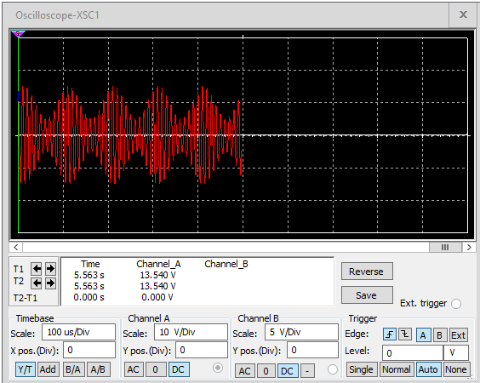
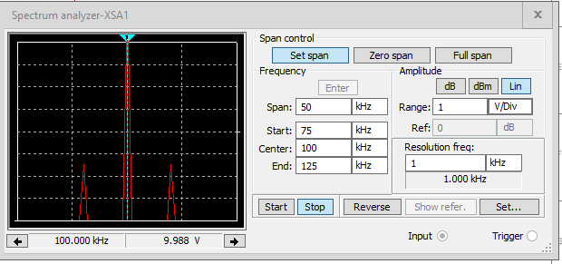
FM Signals
The screenshot of the Oscilloscope should include the signal and the panel settings of the oscilloscope. The screenshot of the Spectrum Analyzer should include the signal and the panel setting of the analyzer.
Oscilloscope screenshot here
Spectrum Analyzer screenshot here
What’s the carrier frequency?
9.9 V

Slide 9
Pulse Code Modulation (PCM) and Line Codes

Slide 10
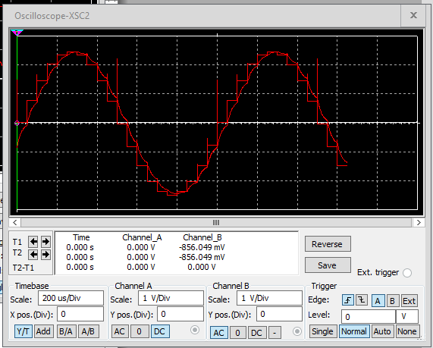
Pulse Code Modulation (PCM)
The first screenshot should show the Oscilloscope-XSC1 display with the analog input signal and sampling clock at the input to the ADC. The second screenshot should show the Oscilloscope-XSC2 display with the output of the DAC.

Slide 11
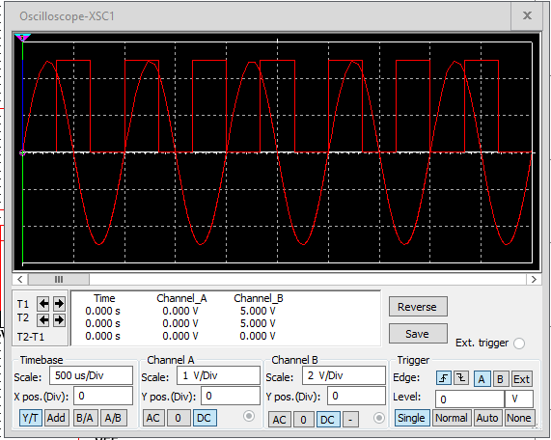
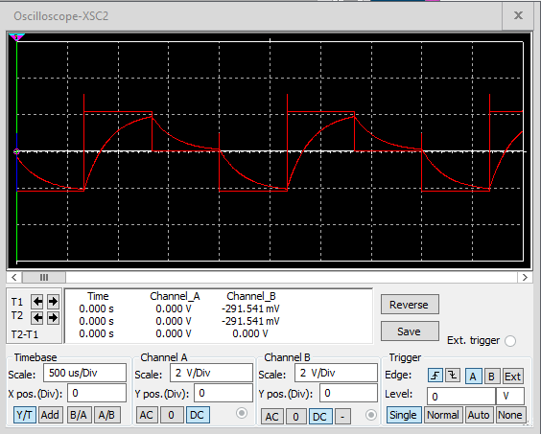
Pulse Code Modulation (PCM)
The first screenshot should show the Oscilloscope-XSC1 display with the analog input signal and sampling clock at the input to the ADC. The second screenshot should show the Oscilloscope-XSC2 display with the output of the DAC.
What are the effects of increasing or decreasing the sampling rate?
Answer: a visual change in the frequency out put, not steady at all

Slide 12
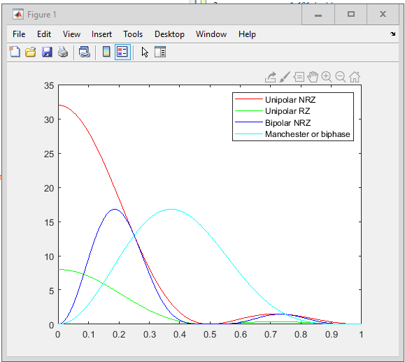
Line Codes
This screenshot should show the power spectral densities of four-line codes: NRZ-Polar, NRZ-Unipolar, NRZ-Bipolar, and Manchester-Polar.
MATLAB Diagram Here
Compare the NRZ-Bipolar and Manchester polar codes in the diagram.
Which one requires more bandwidth?
Answer: Bipolar NRZ requires more

Slide 13
Cables and Structured Cabling

Slide 14
Questions
1. Why must the twisting in the individual wires be maintained in a UTP cable?
Answer: To reduce EMI (electromagnetic interference) and Cross talk
2. How many inches should UTP cable be separated from 110 volts electrical cable?
Answer: The general guideline for the distance between Cat6 cabling and electrical wires is to maintain a minimum separation of at least 12 inches (30 centimeters). This distance helps to minimize the chances of EMI interference.
3. Horizontal cabling connects what areas to each other?
Answer: The horizontal cabling system extends from the work area telecommunications information outlet to the telecommunications room

Slide 15
Questions
4. What is a plenum rated cable?
Answer: Plenum rated cables are considered the safest and highest standard option, and are often used in commercial and institutional settings where safety is a top priority. However, they are less flexible than other cables and can be very rigid and hard to bend plenum rated cable is designed to: restrict flame propagation to no more than five feet.
5. What is a riser tube used for?
Answer: Riser cable is cable that is ran between the floors in non plenum areas. They get their name because of the way riser cable is ran which is rising up to each floor. Riser cable is important in that it can be a buildings backbone that transmits data, audio and video signals.
6. Is the grounding of equipment mostly a safety or a performance concern?
Answer: its for safety of the person using it and the equipment

Slide 16
Antenna Gain and Free Space Path Loss

Slide 17
Antenna Gain
1. What is the maximum theoretical antenna gain of a common dish antenna at the 2.4 GHz band? [4 points]
Answer: 22.379
2. What is the maximum theoretical antenna gain of a common dish antenna at the 5 GHz band? [4 points]
Answer: 29.079
3. Given the same sized reflector, which signals, high-frequency, or low-frequency, can be more efficiently focused by a common dish antenna (i.e., result in a higher antenna gain)? [5 points]
Answer: 5ghz band
4. What is the maximum theoretical antenna gain of the dish antenna used in the VLA radio telescopes in New Mexico at the 5 GHz band? [4 points]
Answer: 63.059
5. Given the same signal frequency, which dish antennas, large-sized or small-sized, are more efficient at focusing the signal (i.e., result in a higher antenna gain)? [5 points]
Answer: Large-sized

Slide 18
Free Space Path Loss
1. What is the free space path loss in dB at the 2.4 GHz band? [4 points] Answer: -80.4
2. What is the free space path loss in dB at the 5 GHz band? [4 points] Answer: -87.2
3. How does the free space path loss at a higher frequency (e.g., the 5 GHz band) compare with that at a lower frequency (e.g., the 2.4 GHz band)? [5 points]
Answer: the 2.4ghz frequency is less prone to loss the
4. What is the free space path loss in dB over 20 meters at the 2.4 GHz band? [4 points]
Answer: -66.421
5. What is the free space path loss in dB over 40 meters at the 2.4 GHz band? [4 points]
Answer: -72.441
6. What is the free space path loss in dB over 80 meters at the 2.4 GHz band? [4 points]
Answer: -78.462
7. When the distance doubles, how does free space path loss in dB change approximately? [5 points]
Answer: it increases by approximately 6 dB

Slide 19
Free Space Path Loss Cont.
8. Use a scientific calculator to calculate Delta $L_{fS}$ for D1 = 20 meters and D2 = 40 meters. [4 points]
Delta $L_{fS }$= _6.02dB__________
9. Is your calculation approximately the same as the result from Part 1 Step 2? [4 points]
Answer: yes

Slide 20
Bit Error Rate of Fading Channels

Slide 21
AWGN Channel and Rician Channel
This screenshot should show the bit rate error performance of both AWGN and Rician fading channels.

Slide 22
AWGN Channel and Rician Channel
Compare and contrast the BER performance of PSK over a noise limited (AWGN) transmission channel to the performance of PSK over a Rician channel at 5- and 10-dB Signal to Noise Ratio (E_{b}/N₀), respectively.
Is there a significant difference in BER performance of PSK between the AWGN channel and Rician channel?
Answer: yes there is a significant difference in contrast

Slide 23
Career Skills
Explain Key Components & Functions of a Communication System
Understand the Methods and Techniques of Transmission, conversion and reception of analog data
Differentiate Cryptographic algorithms and their applications.
Examine the behaviors and applications of transmission lines and optical communication.
Differentiate the antenna types and wave propagation in various wireless applications.
Interpret application security, device security, and physical security.
Exam authentication and access control techniques.

Slide 24
References
DeVry Library
Interactive Assignment Modules
Citrix Workspace
MatLabR2019a

Slide 25
Conclusion
Overall, this class was moderately intriguing, Tho met with many challenges with the vendors systems we were using that caused quite a bit of anguish and inconsistency for the dynamic of the class, also it being my first class with no live sessions was an adjustment as well, but the material and the subject matter itself was not bad and piggybacked on previous classes around networking and security as well. So, it will help other students move forward on their path.

